Slide 1
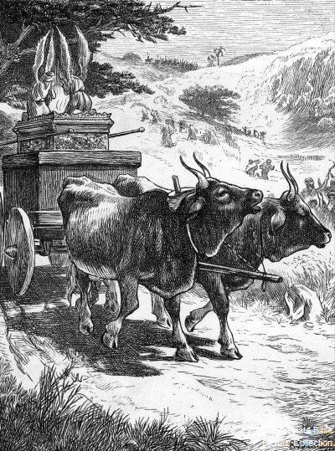
GOD’S GLORY
DEFENDED!
1 SAMUEL 6
Chpt 4: God’s glory is
departed from Israel.
Chpt 5: God’s glory is defended against the pagan Philistines.

Slide 2
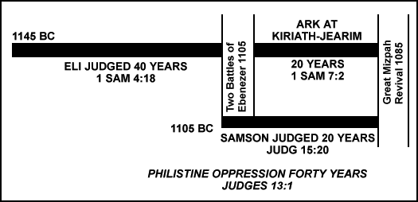

Slide 3
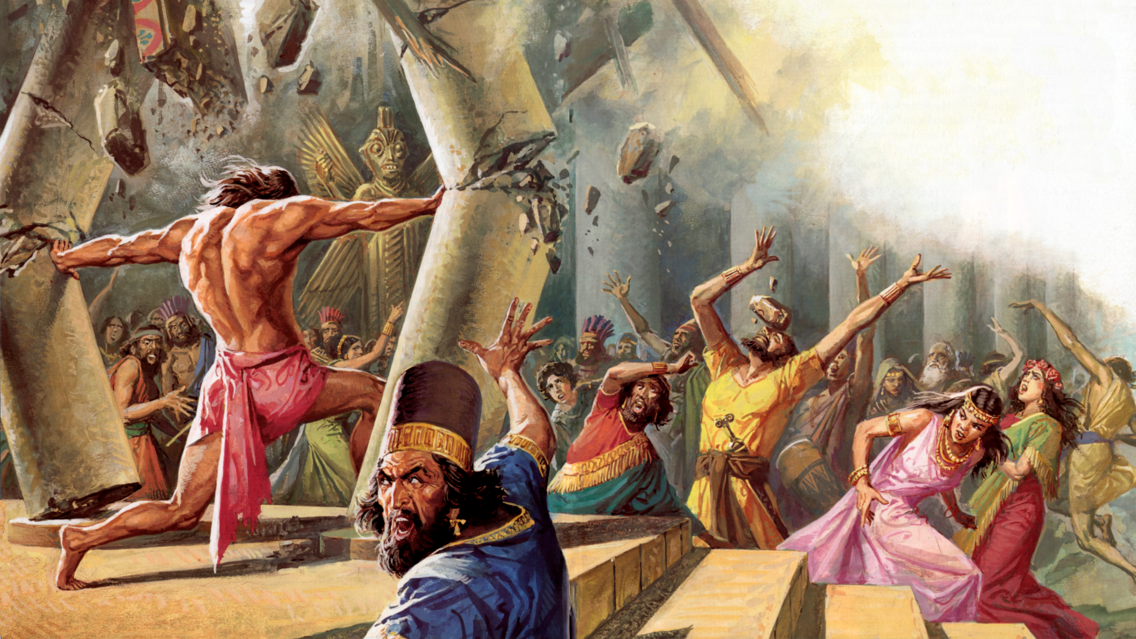

Slide 4
GOD’S GLORY
DEFENDED!
1 SAMUEL 6
Chpt 4: God’s glory is
departed from Israel.
Chpt 5: God’s glory is defended against the pagan Philistines.
Chpt 6: God’s glory is defended against the Israelites.

Slide 5
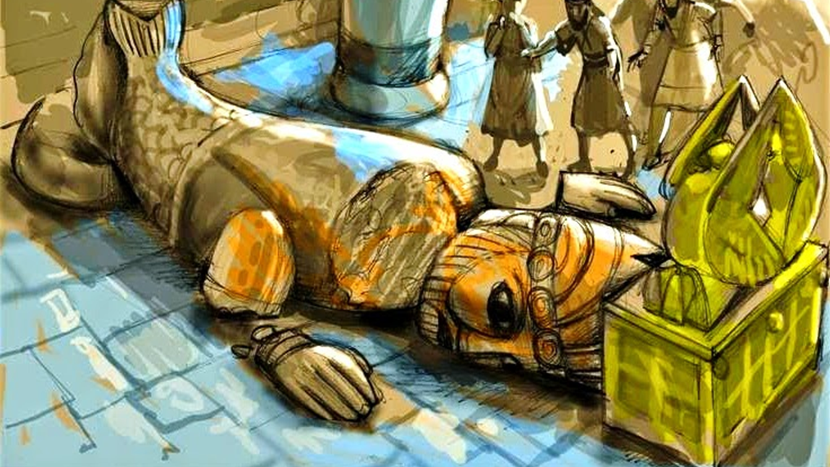
7 months of suffering before the Philistines seek repentance.

Slide 6
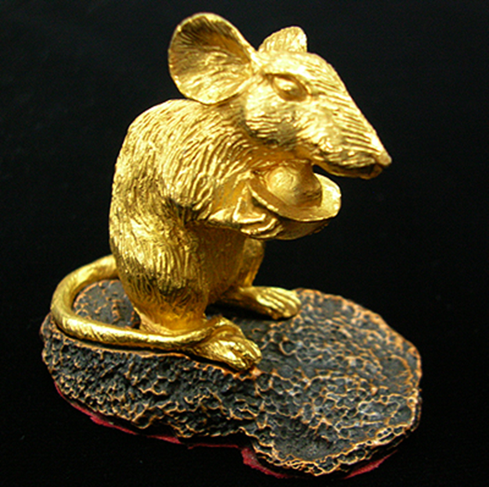
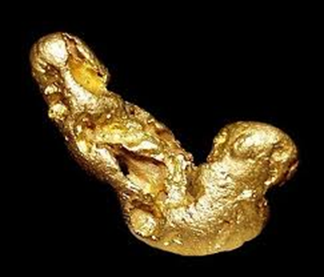
The Sad Solution?
More presumption. Strike 1!

Slide 7
Galatians 6:7-8a Be not deceived; God is not mocked: for whatsoever a man soweth, that shall he also reap. 8 For he that soweth to his flesh shall of the flesh reap corruption; but he that soweth to the Spirit shall of the Spirit reap life everlasting.

Slide 8
The Sad Solution?
More presumption. Strike 1!
  Destruction “images of your mice that mar the land.”
  Death
  Derriere – “Wherefore ye shall make images of your Emerods”
Call for the ministers of Dagon. Strike 2!
They decide to GET RID of God rather than GET RIGHT with God! Strike 3!
This is the problem with the mentality of the lost mind; it wants God to just “go away and leave me alone!”

Slide 9
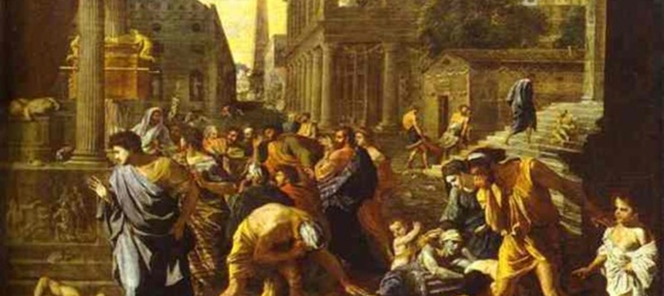
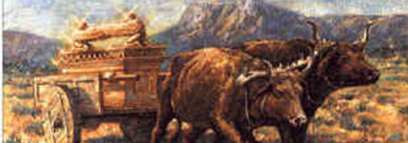
The revealed conclusion.
They knew the cows would go straight home for their crying calves. They knew that only divine intervention would keeps the cows from their calves.
They were wrong in their presumptions against God, but the cows were right
with Him!

Slide 10
Isaiah 1:3-4 The ox knoweth his owner, and the ass his master's crib: but Israel doth not know, my people doth not consider. 4 Ah sinful nation, a people laden with iniquity, a seed of evildoers, children that are corrupters: they have forsaken the LORD, they have provoked the Holy One of Israel unto anger, they are gone away backward.

Slide 11
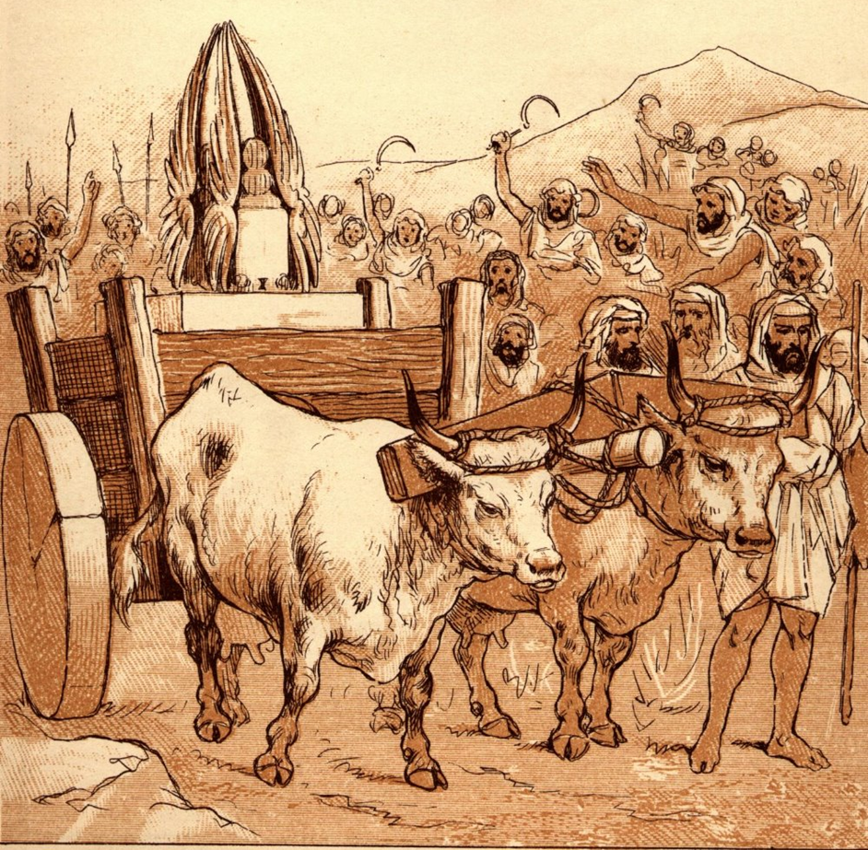
Were those cows smarter than some of us this morning?

Slide 12
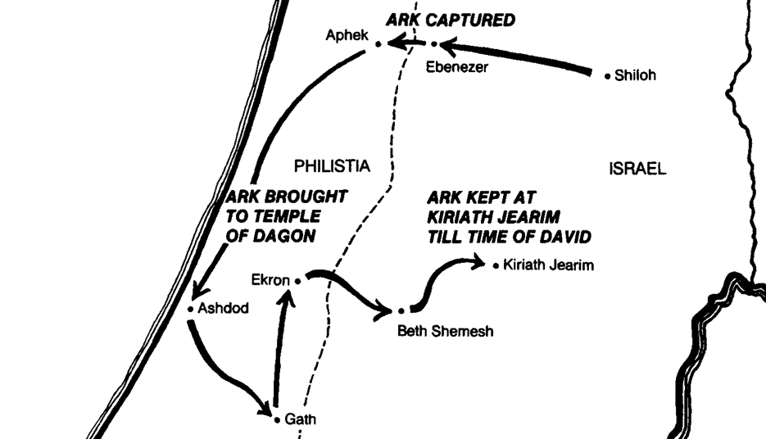

Slide 13
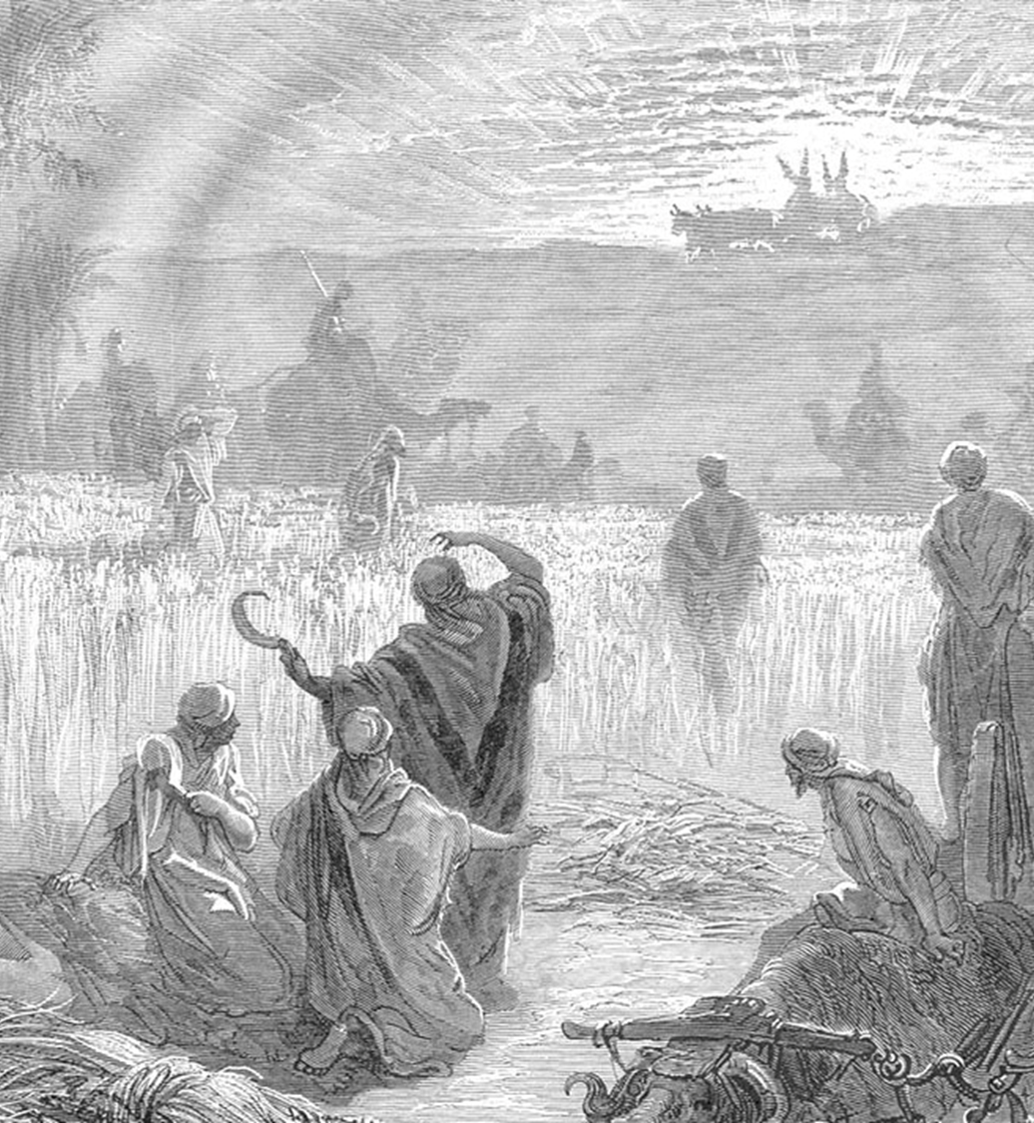
The Ark, Received with Rejoicing!
Bethshemesh = “house of the
sun.” It is a place and time of harvest.
Jesus =
  The “Sun of righteousness”
  “That Rock” 1 Cor 10:4

Slide 14
Colossians 3:1-4 If ye then be risen with Christ, seek those things which are above, where Christ sitteth on the right hand of God. 2 Set your affection on things above, not on things on the earth. 3 For ye are dead, and your life is hid with Christ in God. 4 When Christ, who is our life, shall appear, then shall ye also appear with him in glory.

Slide 15
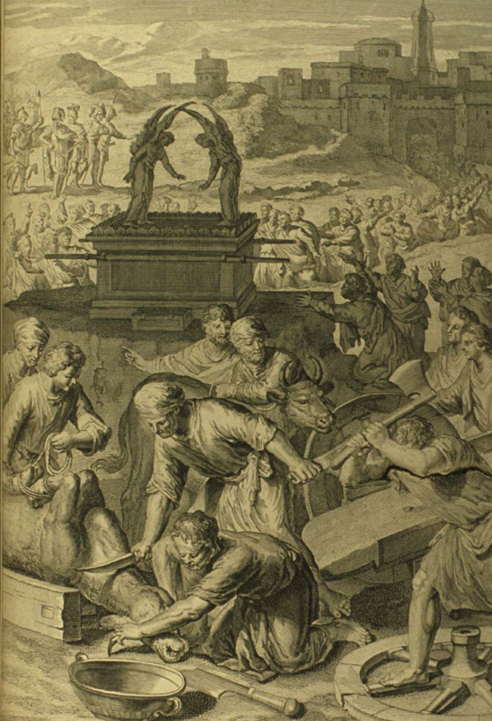

Slide 16
The Ark, Regarded with Regret!
Presumption again!?
50,070 people died!
There are no scribal errors in God’s preserved Word!
Too many of us, when God is chastising us, just want God to go away instead of wanting to get right with Him!
But our hearts long to be in right relationship with the Lord!

